Slide 1
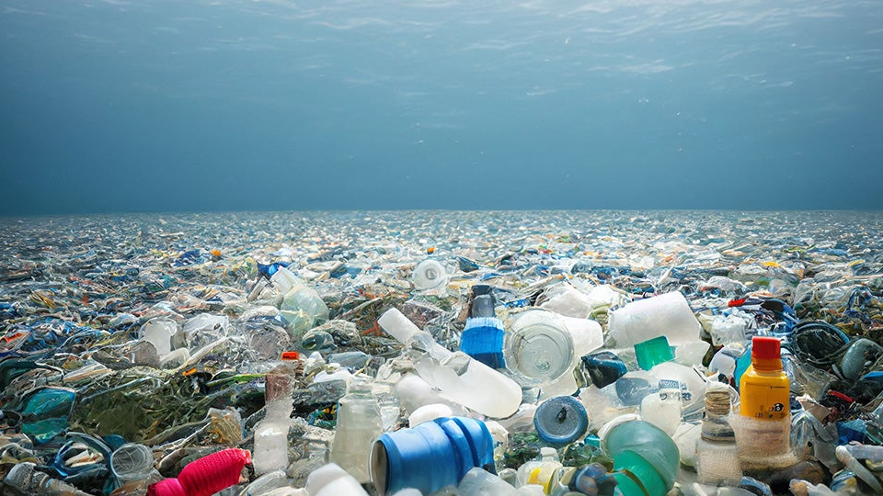
Our ocean needs you! XXX BN of plastics bottles finish each year in it, help us prevent it!
Click on start!
START
Instructions:
Catch as many bottles as possible before they land into the ocean!
Arrow left → move the small net left
Arrow right → move the small net right
Arrow up → move the small net up
Arrow down → move the small net down

Slide 2
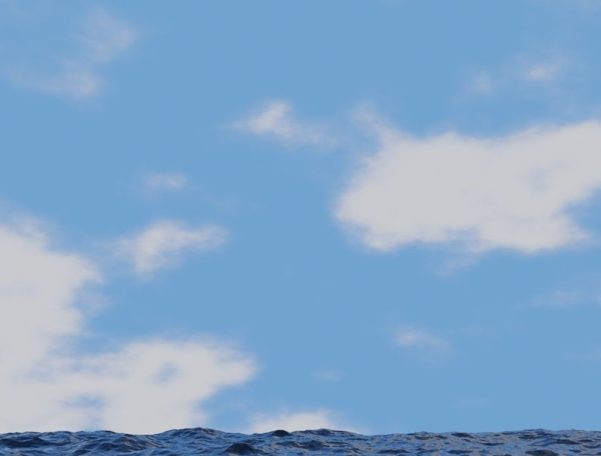
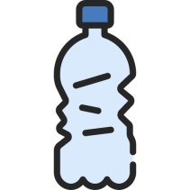
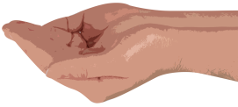
Bottles rescued : xxx
Lives: 3
Notes:
When each bottle touches the ocean – 1 life.
If the net didcollide with bottle +1 bottle rescued.
Incrementing the speed after a certain amount of time.

Slide 3
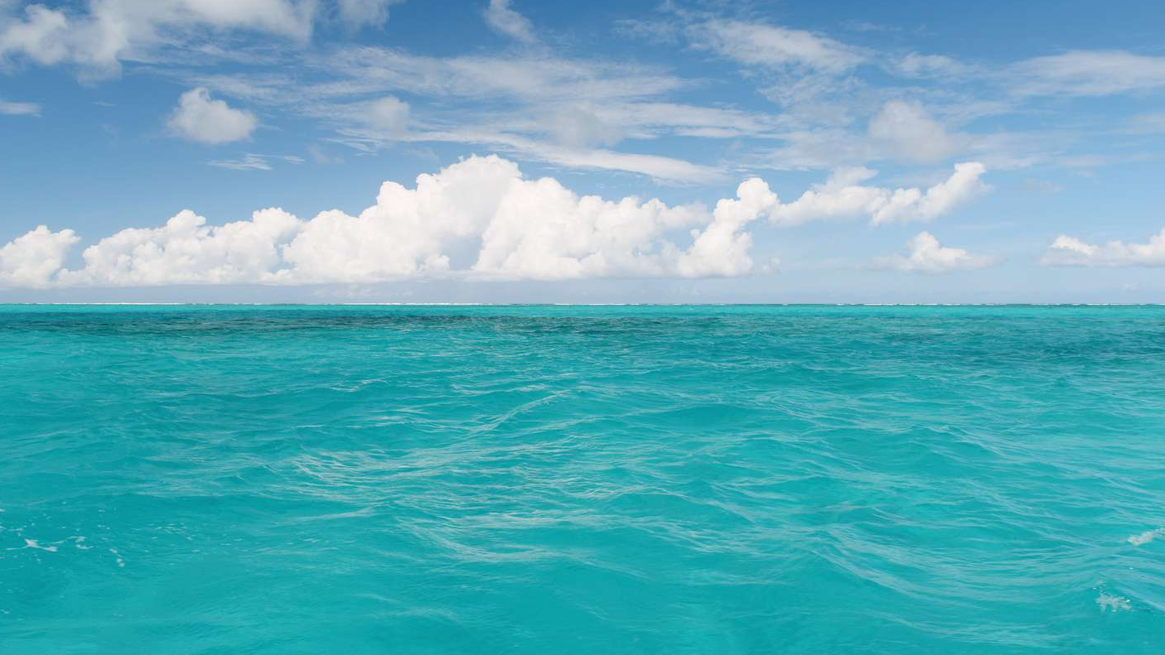
Great! With to your effort you prevented xxx plastic bottles and xxx kg of plastic to finish into the ocean!
We would need just xxx persons like you to clean the entire ocean from wasted bottles!
Click on RE-START to play again!
RE-START
Notes:
Bottles > 20

Slide 4
Oh no! It seems you weren’t paying too much effort! Our ocean still needs you!
Click on RE-START to play again!
RE-START
Notes:
Bottles <= 20

